Slide 1
Object Oriented Programming Part 7: Interfaces
By: Ryan Alterman
Revised: 10-25-17

Slide 2
What is an interface?
It describes the behavior or capabilities of the class
But it keeps the implementation from being strict and set in stone
This is achieved using abstract classes
This is NOT the same as data abstraction
A class can be made abstract by making at least one function pure virtual
The purpose of Abstract Classes is to create a class that other classes can inherit from
These classes can not be used to instantiate objects, it only acts as an interface
In order to instantiate objects of an abstract class, the virtual functions must be implemented in the derived class.
Classes that do this are called concrete classes

Slide 3
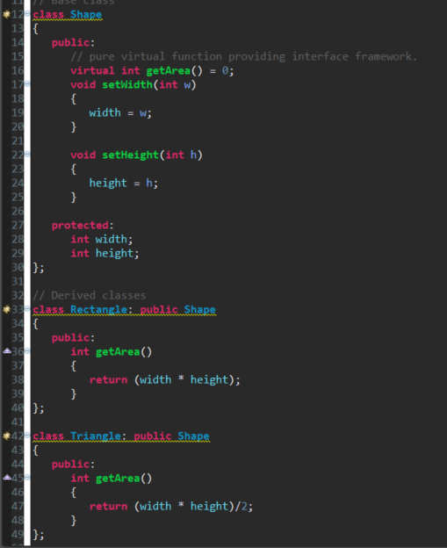
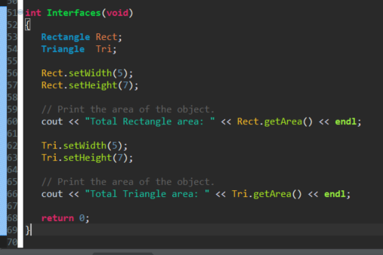
Example using Abstract Class to Interface with Derived Classes

Slide 4
Application of Designing Code
Use it to create common interface applications that gain meaning as it goes into deeper classes
Implementations of the pure virtual function is offered only in the derived class
Which means you have to use inheritance
This system allows new applications to be added easily
The system can be altered even though it is already defined

Slide 5
Challenge
How would we be able to use interfacing in an FRC application? Why would we? Create a class that shows the use of interfacing to accomplish a goal.

Slide 6
This concludes the Object Oriented Programming Series. Please finish the normal lessons if you have not done so already.

